Slide 1

GDPR for Student Groups

Slide 2

CONTENTS
About GDPR
Durham SU’s Data Protection Framework
Responsibilities of Student Groups
Tools and Resources
Student groups and data innovation

Slide 3

About GDPR

Slide 4
WHAT IS PERSONAL DATA?
Any information relating to a living individual who can be identified by for example:
Name
Address
Date of Birth
Identification number
Location data (mobile device collecting data on your location)
Online identifier (e.g. Email, chat, instant messenger, Facebook)

Slide 5
WHAT IS SPECIAL CATEGORY (SENSITIVE) PERSONAL DATA?
Personal data relating to an individual’s:
1. Racial or ethnic origin
2. Political opinions
3. Religious or similar beliefs
4. Trade union membership
5. Physical or mental health or condition
6. Sexual life or sexual orientation
7.Genetics
8. Biometrics (where used for ID purposes)

Slide 6
WHAT IS PROCESSING?
GDPR defines ‘processing’ as:
"any operation or set of operations which is performed on personal data or on sets of personal data, whether or not by automated means, such as collection, recording, organisation, structuring, storage, adaptation or alteration, retrieval, consultation, use, disclosure by transmission, dissemination or otherwise making available, alignment or combination, restriction, erasure or destruction"

Slide 7
7 PRINCIPLES OF GDPR
Process personal data fairly and lawfully
Process personal data for specified and lawful purposes
Only collect the data that you need
Keep data accurate and up to date
Don’t keep data for longer than necessary (whilst upholding individuals rights)
Keep data secure
Accountability

Slide 8
INDIVIDUAL RIGHTS
The GDPR provides the following rights for individuals:
The right to be informed
The right of access
The right to rectification
The right to erasure
The right to restrict processing
The right to data portability
The right to object
Rights in relation to automated decision making and profiling.

Slide 9
Data Protection Framework

Slide 10
DURHAM SU FRAMEWORK
www.durhamsu.com/privacy-policy
Durham SU’s Data Protection and Information Security Policy:
Set by Durham SU’s board of Trustees. This policy describes how Durham SU will meet it’s legal obligations and recognise the data rights of individuals whose data we process. It is monitored by Durham SU’s Audit and Risk Committee.
Durham SU Privacy Statements:
Durham SU has privacy statements that clearly and straightforwardly explain how we process data, why, who we share it with and how data subjects can access their data rights. There is one statement for students and another for employees, suppliers and volunteers.
Data Protection Officer:
Contact on: su.dataprotection@durham.ac.uk
Tasks of DPO
Monitoring compliance with Data Protection laws.
Their DP advice is taken account of
Is the contact with the ICO
Takes into account the risk of processing of data protection
Their details are published and they are available as a point of contact for employees, individuals and the IPO.

Slide 11
HOW STUDENT GROUPS USE PERSONAL DATA
PURPOSE | PROCESSING
Creating mailing lists of potential members | Spreadsheet, sign-up sheet, mailing platform (ie. mail-chimp)
Membership lists for communications, elections etc. | Durhamsu.com
Event attendee lists | Durhamsu.com
Exec team personal details | @durham.ac.uk email address, Facebook group/chat
Trip and event manifestos | Trip forms or spreadsheets
Members’ photos | Google drive or similar

Slide 12
Groups – What To Do

Slide 13
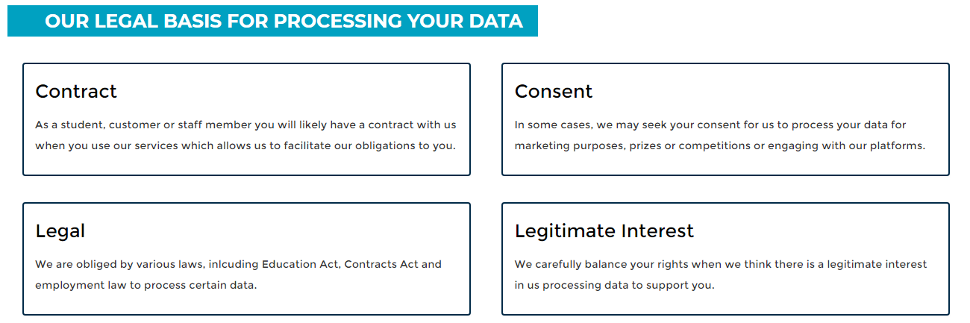
WHAT STUDENT GROUPS NEED TO DO
Process personal data fairly and lawfully
Comply with Durham SU’s policies, privacy statement and data protection guidelines.
If information is processed on a consent basis, making sure that we tell people how they can withdraw their consent
Don’t share data with third parties unless we have consent from the individual to do so

Slide 14
WHAT STUDENT GROUPS NEED TO DO
2. Process personal data for specified and lawful purposes
Make sure you have privacy notices, they link to Durham SU’s privacy page, they are clear simple, and accurately how will use the data you are collecting.
REMEMBER – this includes photos, video, case-studies etc.
Example privacy notice for when using Durhamsu.com mailing function -
‘You are receiving this email because you are a member of Durham SU’s Antipodean Society, to keep you up to date on the events and opportunities you are entitled to as a member of our group. We won’t share your data with anybody else and we’ll only use it to deliver your membership benefits (we won’t send you spam!). To find out more about how Durham SU keeps your data safe or to contact us about your data, please visit - https://www.durhamsu.com/privacy-policy’

Slide 15
WHAT STUDENT GROUPS NEED TO DO
3. Only collect the data that you need
Make sure you have a reason for all the data you collect, and identify whose job it is on your executive team to be aware of this reason, and when you will review it.
‘It’s nice to know’ or, ‘we might need that one day’ is not a reason that the Information Commissioner’s Officer is likely accept!
Make sure all members of your exec know its their job to question how data is used if they’re unsure

Slide 16
WHAT STUDENT GROUPS NEED TO DO
4. Keep data accurate and up-to-date
Take reasonable steps to correct anything you know is wrong
Notify students of how they can update data
5. Don’t keep data for longer than necessary (whilst upholding individuals rights)
Have mechanisms/schedule for removing old data (hint: where possible use @durham.ac.uk email addresses.
Know how long you need to hold the data

Slide 17
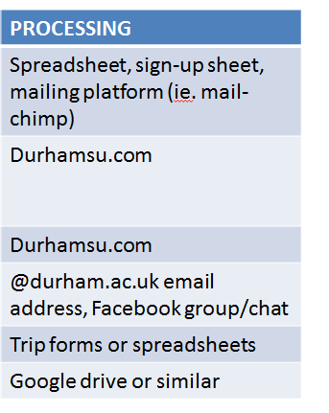
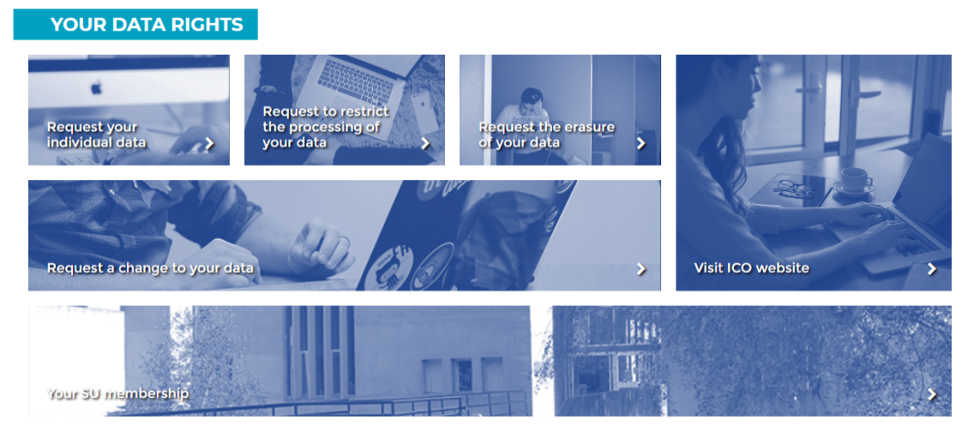
WHAT STUDENT GROUPS NEED TO DO
6. Keep data secure
Know who has access to the data you hold, and don’t allow people who don’t need access to have it. If storing on a device or platform, ensure that device or platform can be password secured.
7. Accountability
Be able to evidence that you’ve considered people’s data rights under GDPR. Report any breaches ASAP. Refer to Durham SU’s privacy page and notices, with the details of how people can object, rectify, request etc their data.

Slide 18
WHAT STUDENT GROUPS NEED TO DO
Definition of a data security incident
An unexpected event leading to the accidental or unlawful destruction, loss, alteration, unauthorised disclosure of, or access to, University information (paper or electronic)
Email su.dataprotection@durham.ac.uk, or any SU staff member if you become aware of a breach.

Slide 19
Groups – Resources

Slide 20
TOOLS & RESOURCES
https://www.durhamsu.com/privacy-policy
https://ico.org.uk/for-organisations/guide-to-the-general-data-protection-regulation-gdpr/
GDPR : ASK SU
https://www.durhamsu.com/resources/student-groups-guidance-and-template-for-collecting-sign-ups-for-student-groups
Data Protection module on DUO

Slide 21
Data and Innovation

Slide 22
DATA AND INNOVATION
Share best practice! Found a good solution that reduces how much you have to handle data? Share it with us so we can share it with other groups.
Ask questions about your, and your members data is being used
Tell us about how you use your data if you think it’s unusual, so we can keep an eye out for tools and solutions
Tell us your groups concerns or questions about how you use data – chances are other groups do something similar

Slide 23
QUESTIONS

