Slide 1
STUDENT GROUP FINANCE TRAINING 2018/19

Slide 2
Overview
Each society has its own pot of money which sits under one bank account controlled by the Students’ Union. The society then operates like a mini organisation, so making sure your society’s funds are well looked after is important.
Every society will have multiple sources of income and expenditure and all of these should be considered throughout the year.
Notes:
Gavin

Slide 3
Your role as a Treasurer;
To manage society funds.
Overall responsibility for the administration of finances.
Not making a loss/ going overdrawn.
To ensure when planning events or weekly activities the cost & VAT have been taken into account.
To ensure funds are managed appropriately and keep accurate records of income and expenditure.
Raising all PO’s.
Budgeting.
Gain an understanding of the expense app 365 training guide.
Follow the Students Unions’ financial procedures and regulations.
Sunday-Friday payment cycle.
To submit invoices/receipts for payments/reimbursements.
Use the expense 365 app for claiming expanses to a minimal level.
Notes:
Gavin

Slide 4
Your Account
Durham Students’ Union is a non-profit making charity.
Durham SU has to comply with UK charity laws.
So do you!
All societies have their own reserves within the Students’ Unions main bank account; this is distinguished by a three digit code specific to your group.
You cannot at any time hold money in any external accounts!
Money can only be spent with the authorisation of the exec; SU staff will not do anything without your written permission.
Notes:
Gavin

Slide 5
Spending from your account
All spending must meet the aims and objectives set out in your society’s constitution.
Spending must benefit ALL members
You also do not have an overdraft!
If your group goes into debt (negative balance), your account will be suspended for 7 days.
During this time you must fundraise to get your society ‘back into the black’.
After the 7 days, if your society still has a negative balance you will have to continue to fundraise until the balance is cleared
As a charity the SU are unable to provide funds to groups who mismanage their finances.
Notes:
Gavin

Slide 6
What finance means to you!
Where your money comes from:
Types of income;
Membership.
Student group grants.
Fundraising events.
Non-fundraising events (Ticket sales).
Sponsorship & donations (VAT difference).
Where your money goes:
Types of expenditure;
Purchases.
Reclaim expenses.
Pay invoices.
Notes:
Gavin

Slide 7
Membership
There are some small rules and regulations that we must adhere to:-
Membership fees are to be paid via the SU website with NO exceptions. This ensures that all current members are accounted for and covered by the Students’ Union insurance policy.
There is no minimum membership fee for student groups but societies will be less likely to receive grant funding if they don’t set a membership fee.
Registration and payment MUST be collected via the SU website – membership should not be taken any other way , this ensures all members are covered by the SU’s insurance policy.
Student group secretary has administration rights to the website and can run membership reports to cross reference income.
Statements are more easily retrieved via the expense 365 app.
Notes:
Gavin

Slide 8
Membership
When determining membership fees, Student Groups should consider:
What activities do you intend to do throughout the year?
How much will they cost?
How are you going to pay for it?
We’ll talk about budgeting later…..
Notes:
Gavin

Slide 9
Membership Income & VAT
VAT is a very complex area, but does have implications for student groups.
There are two types of student groups, and the VAT treatment is different for each.
Notes:
Gavin

Slide 10
Membership Income & VAT
Non Active Groups
These are non physical in their aims and objectives, so this would include political groups, academic groups and cultural groups.
Memberships charged for these groups include 20% VAT, which means:
For every £120 of membership charged, you retain only £100, the remainder goes to the government.
However, these groups can reclaim VAT on all costs where appropriate.
Notes:
Gavin

Slide 11
Membership Income & VAT
Active Groups
Active groups are those which involve physical activity, so sport, exercise, dance,.
The government defines the activities – not us.
These groups get to keep all the money from memberships, and also for any fees that relate to carrying out that activity (ticket fees for hillwalking).
The downside is that they cant claim back the VAT on activity related expenditure.

Slide 12
Membership Income & VAT
For all other income, whether a society is active or not, VAT on the income and expenditure will be handled the same way.
Ticketed Events, Sponsorship etc.
These are transactions essentially of a commercial nature – so a society ball will always include 20% of VAT that goes to the government.
The upside again is that VAT can be reclaimed.
As an example, if a dance society charges to perform, this includes VAT, but any costs of putting on the show can have the VAT reclaimed.
Notes:
Gavin

Slide 13
Membership Income & VAT
Membership Income & VAT
Fundraising Events , Donations and Grants
For fundraising events, where clearly advertised as such, all income will be free of VAT. This is because such events are raising income to be donated to a charity- but conversely, the society cannot reclaim the costs of VAT of such an event.
Donations and Grants will be received in full without deduction of VAT. As generally they are only making a contribution to the running costs of the society, they are unlikely to affect the ability of an individual society to reclaim VAT

Slide 14
VAT on Expenditure
Whether or not VAT can be claimed back when making a purchase depends on a couple of things:
Is the purchased item vatable?
Is there a VAT invoice/receipt with the relevant breakdown?
If not then you cant claim it back, typical example is hand written receipts.

Slide 15
The 4 available Student Group Grants
Start-up Grant Up to £100 Within 3 months (not including holidays) of being ratified For equipment and event to get students engaged Not for food and drink | Ordinary Grant Up to £1000 in total with any other grants Multiple times throughout the year (first deadline – TBC. For equipment and one-off events Not for food and drinks or regular events
Special Grant Up to £1000 in total with any other grants For unforeseen circumstances (these do not include not receiving an ordinary grant) Deadline passed | General Grant Info There is one form for all grant applications and it is available on the website All applications go to Governance & Grants Committee which decides if and how much of a grant will be awarded.
Notes:
Gavin

Slide 16
Student Group Grants
All grant applications are to be sent to dsu.engagement@durham.ac.uk .
A grant will be given if and only if:
It fulfils the objectives of a society;
One of the exec has attended the finance training;
You have attached an extra document detailing your budget for each planned event.
The applications are reviewed by the Governance & Grants committee, comprised of students. Their decisions will be relayed to you in due course.
Notes:
Gavin

Slide 17
Sustainability: Budgeting & Forecasting
A budget is a concrete, organised and easily understood breakdown of how much money is coming in and going out.
What type of ‘things’ might you budget for?
Activities;
Think about what types of activities you intend to run throughout the year for your members and then set the membership fee accordingly.
Equipment;
Think around any equipment your society currently holds and may need replacing or any new equipment you will need to achieve your aims and objectives and set the membership fee accordingly.
‘One off’ events;
Summer/Winter socials, Ball’s. these tend to be costly and require deposits paying in advance, we advise that you over budget by 10% as a contingency and set your ticket price accordingly to cover all costs.
Notes:
Gavin

Slide 18
Please note;
When planning large scale events such as ‘balls’ the Students Union are required to counter sign any contractual booking agreement on your societies behalf.
No payments will be made until we have received a risk assessment for the intended event. So please be aware before you make any enquiries.
Notes:
Gavin

Slide 19
Transaction reports
Notes:
Gavin

Slide 20
Transaction reports
The previous slide is an example of a society finance transaction report.
These are sent automatically to the society e-mail address, or is accessible in real time via the Expense365 app.
It is important that we have a generic Durham e-mail address for each society as it will remain consistent over the years as exec members change.
The reports update at the end of each month.
Notes:
Gavin

Slide 21
Forms & Processes
Next academic year we will be moving to ‘one form’ does all which will be available on our website.
Purchase Something;
We can and will purchase ‘larger’ items on your behalf, we ask that you provide full details & links into an email.
Pay in cash or cheques at reception;
This could be for fundraising activities, sponsorships, donations. Please note that membership fees are only to be paid via the website.
If paying in a cheque we ask that you provide the name of your society, what the cheque is for (sponsorship etc.) and your student email in case of error. Please note that ALL cheques must be made payable to Durham Students’ Union.
Send out an invoice for income;
This could be for sponsorship, donations. We ask that you provide full details of who we are to invoice on your behalf, such as contact details
Request a Float;
If you require a float for any reason, reception will help you action this.
Notes:
Gavin

Slide 22
Claiming back expenses
The Expense365 App is replacing expense forms as an easier and more efficient way for students to claim back expenses from society accounts. This is with a view to completely eliminating paper forms for the beginning of next year.
Society execs should make sure they are members of the group via the website and download the app. The app is live and can be used for all expense claims made by members of a society.
The app can be found in the App Store or Google Play Store. An instruction guide can be found on the Union website and there will also be a tablet at reception.
Notes:
Gavin

Slide 23
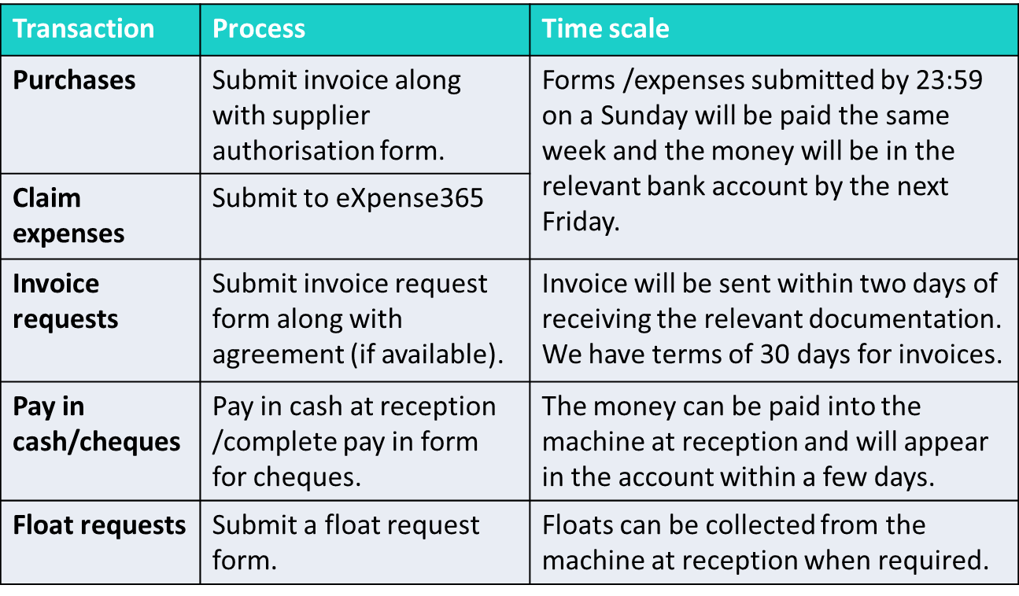
Forms & Processes - Overview
Notes:
Gavin

Slide 24
Useful contacts
dsu.accounts@durham.ac.uk
dsu.invoices@durham.ac.uk
dsu.engagement@durham.ac.uk
We are here to help – give us a ring or email and we’ll arrange to meet if we are not able to resolve any queries there and then.
Notes:
Gavin

Slide 25
HEADING (RESIZE BOX TO FIT)
FIN…
Notes:
Gavin

